Slide 1
IOT Smart Watch
Group 2.

Slide 2
Flow Of Presentation
Introduction to the Problem Statement
Hardware and Software Specification of Components Used
Accurate Circuit And Block Diagram
Challenges Faced
Future Scope
Limitations Of the Prototype
The Budget Estimate Of the Project

Slide 3
Introduction to the Problem Statement
PROBLEM STATEMENT:
SMART WATCH with SOS using IOT
“Today, in the current global scenario, Women were facing lot of challenges. We can hear the news of women harassments than their achievements. Though the smart phones have increased rapidly, it is not possible to have the phone all the time in our hand to make a call or click on it, so here we introduced a new technique via smart watches. When a women or child wearing this `watch me' is exposed to vulnerable attack, He/She can press the SOS Button and it will automatically notify to our registered contact and also through GPS/GSM it will detect the nearby police station and make an ring there so it will be helpful for police to arrive soon at the spot by tracking the GPS, such a system will lead to safer and better environment.”

Slide 4
Hardware and Software Specification of Components Used
1
HARDWARE USED:
Nodemcu,: It is a development board which runs on the ESP8266 with hardware based on the ESP-12 module.
OLED display
Breadboard, Jumper wires, push buttons
SOFTWARE USED:
ARDUINO IDE

Slide 5
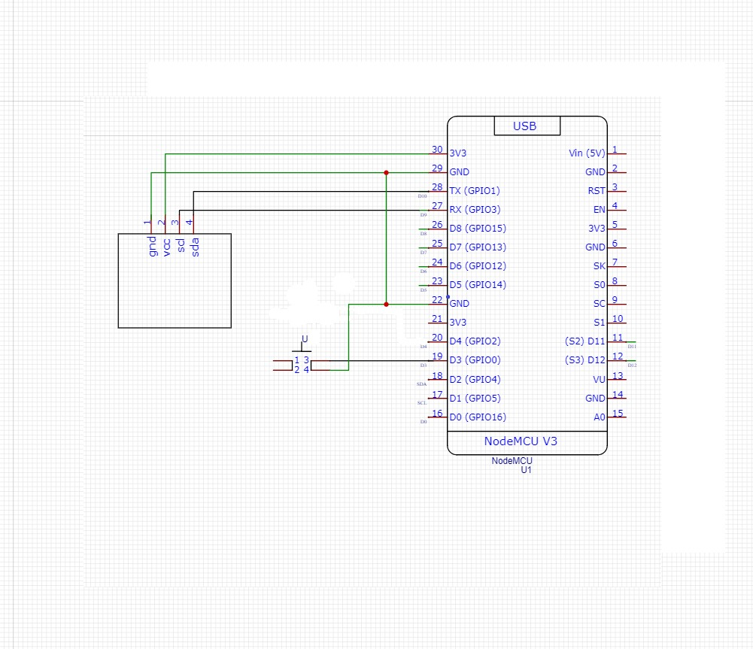
Accurate Circuit And Block Diagram

Slide 6

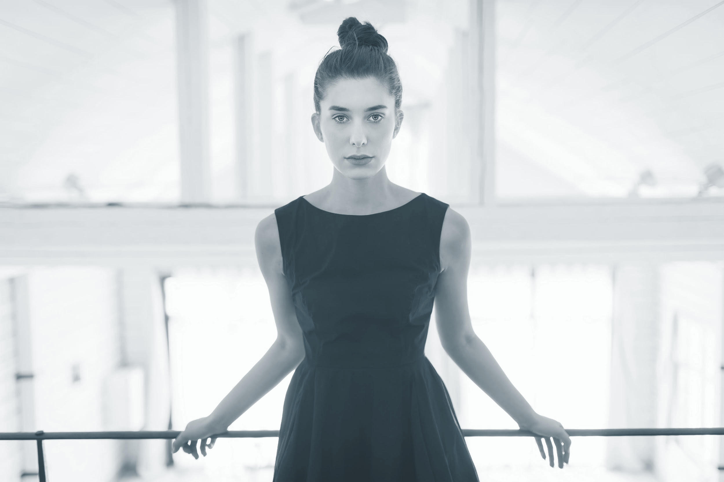
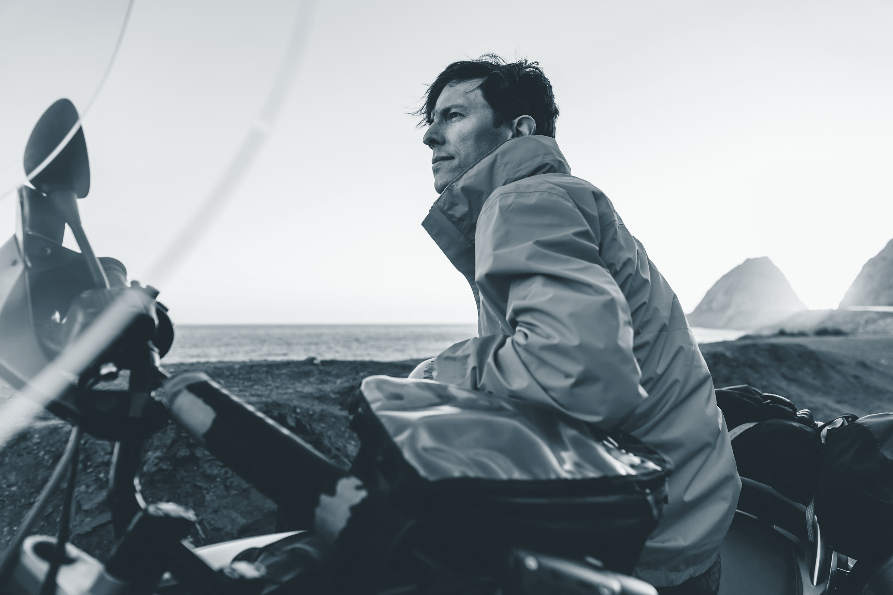
Challenges Faced
Making the smart watch it self is a challenge for all of us. Because of 1st project using IOT.
Making circuit diagram was not big issue but connecting properly was a issue.
Changing value on firebase was biggest challenge for our team.

Slide 7
Future Scope
People will be expecting wearables technology to take over their lives &
they can be proven right in the not-so-distant future.
For efficiency: Charging using solar energy can be used instead to ensure
better longevity
These devices will be made invisible ,making them more powerful and efficient
These devices will be taking all kind of biological data of our body for analysis
Of our health.
“The future looks bright .Smart watches are a great prospect that will earn a lot of money
And also make our lives easier in every possible way.”

Slide 8
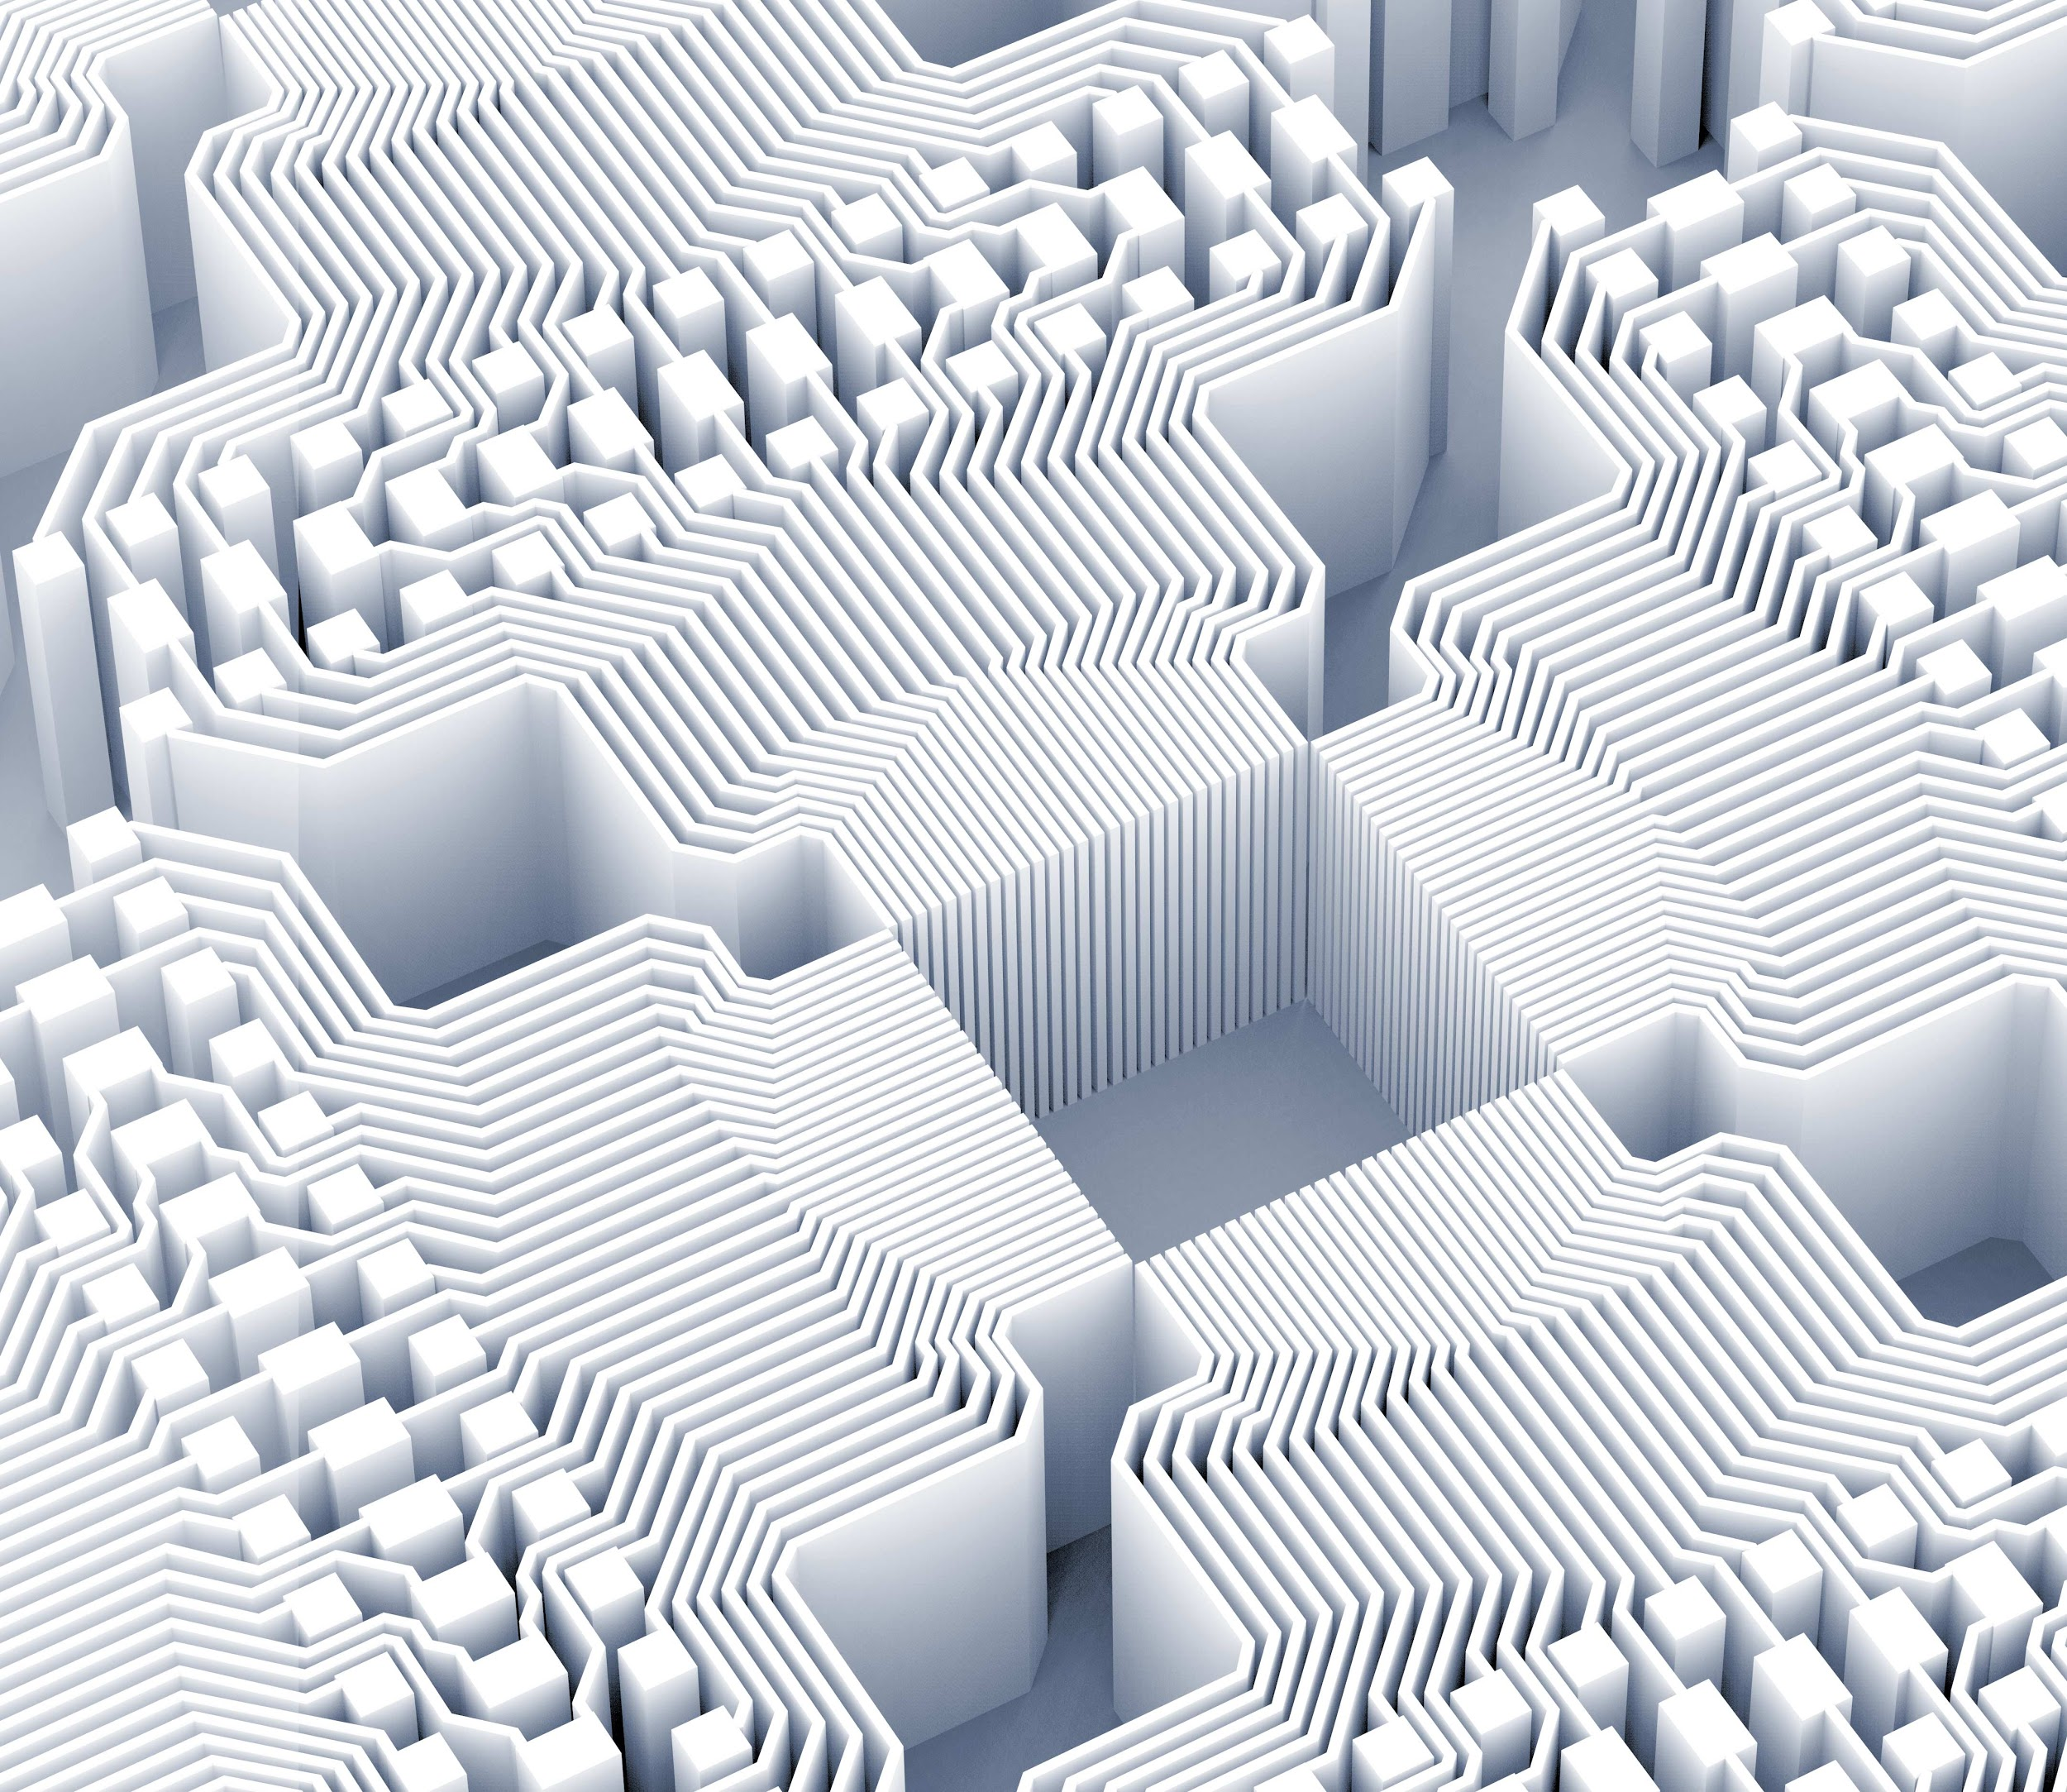
Spotlight on wearables
Limitations Of the Prototype
It consumes 10% more power than Bluetooth based smart watch.
Unable to manage interfaces.
Cannot work without internet connection.
Location can’t be sent via SOS.

Slide 9
The Budget Estimate Of the Project
Nodemcu : 350
OLED Display : 300
Breadboard : 200
Total : 850

Slide 10
Thank you!
Thanks to CEV team for your continuous guidance , support & your valuable time..

